Slide 1

Strong Authentication with Adaptive Authentication
WSO2 Identity Server Fundamentals

Slide 2
Authentication

Slide 3
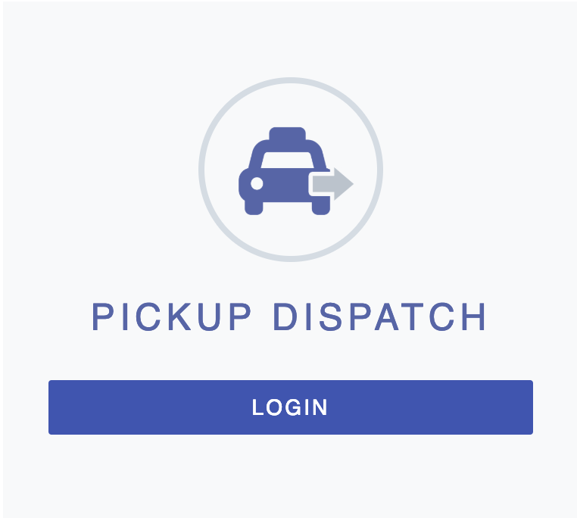
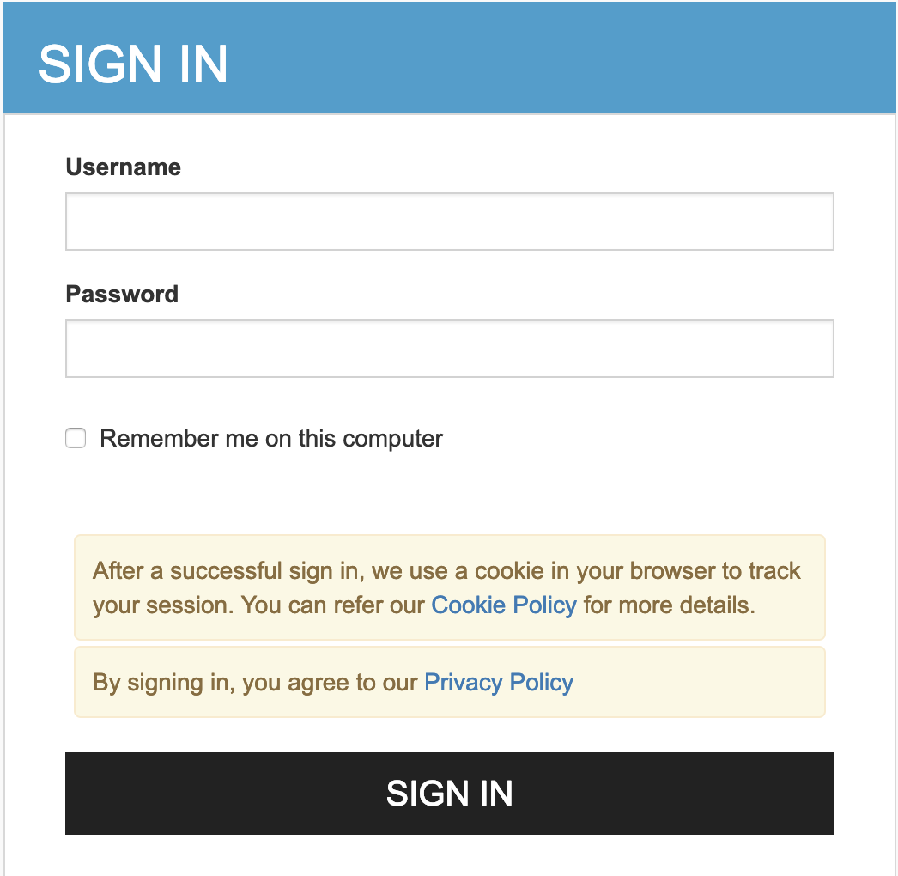
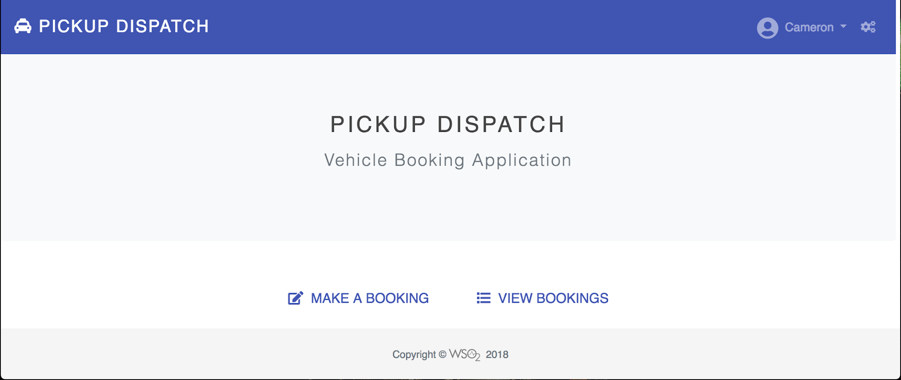
What is Authentication?
Authentication is the process used to distinctly identify a certain entity using:
  Knowledge factor: Something the user knows, e.g., password, PIN, and security question.
  Ownership factor: Something the user has, e.g., ATM card, identity card, mobile phone, and security token.
  Inherence factor: Something the user is/does, i.e., biometrics.

Slide 4






Authentication Mechanisms Based on the Number of Factors
Authenticating users by challenging with multiple authentication steps
Application
Application User
[John Doe]
Identity Provider (IdP)
WSO2 Identity Server

Slide 5

Convenience and Security in Multi-Factor Authentication
What to prioritize
Convenience
Security

Slide 6
Adaptive Authentication

Slide 7
What is Adaptive Authentication?
Adjusting the authentication strength based on the user’s risk profile and behaviour.

Slide 8
Decision Factors
Request or environment factors
User attributes and roles
The required level of assurance (LoA)
User behavior
Analytics and machine learning
And more ...

Slide 9
Adaptive Authentication Scenarios

Slide 10
Role-Based Adaptive Authentication
Application User
[John Doe]
Application
Identity Provider (IdP)
WSO2 Identity Server
Application Manager
[Jane Doe]

Slide 11


Device-Based Adaptive Authentication
Laptop
Application User
[John Doe]
Application
Identity Provider (IdP)
WSO2 Identity Server
Tablet

Slide 12
IP-Based or Location-Based Adaptive Authentication
Own Country
Application User
[John Doe]
Application
Foreign Country
Identity Provider (IdP)
WSO2 Identity Server

Slide 13

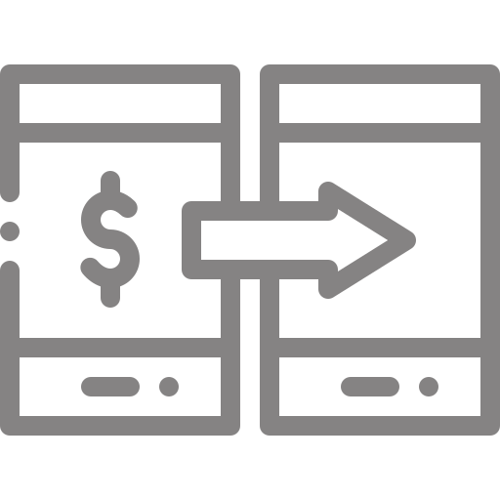
ACR-Based Adaptive Authentication
Balance Inquiry
Application User
[John Doe]
Application
Identity Provider (IdP)
WSO2 Identity Server
Fund Transfer

Slide 14


ELK Analytics-Based Adaptive Authentication
Risk Analyzer
Low Risk
Fund Transfer
Application User
[John Doe]
(no recent large transactions )
Risk Analyzer
Application
High Risk
Identity Provider (IdP)
WSO2 Identity Server
Fund Transfer
Application User
[Jane Doe]
(transferred >$10k within last 5 minutes)

Slide 15
TypingDNA-based Adaptive Authentication
Pattern match
Application User
[John Doe]
Application
Identity Provider (IdP)
WSO2 Identity Server
Pattern mismatch

Slide 16
Quick Recap

Slide 17

About authentication
Benefits of using adaptive authentication
Adaptive authentication decision factors
Adaptive authentication scenarios
What you learnt

Slide 18



Any Questions ?
Reach us through the following channels
iam-dev@wso2.org
https://stackoverflow.com/questions/tagged/wso2-identity-server
https://discord.com/invite/Xa5VubmThw

Slide 19
Thank you!
Notes:
Acknowledge that it’s been a lot of changes within the team
Thank you for your taking onboard the feedback and being open to change.
A lot of work , a lot of learning, sometimes feeling twice the exhaustion
But also hopefully seeing what I see, which is: better ways of working, more innovation in our approach, more business acumen, more effective reactivity , more ahead of the game. Because that’s where marketing needs to be.
All this in a context where it’s also been a lot of changes for WSO2.
And from this standpoint I wanted to remind you of what Sanjiva said about you owning the culture

